Slide 1

6CCS3AIN 2020 Lecture 8B: Argumentation
Peter McBurney
(with thanks to Elizabeth Black)

Slide 2
This Week (Lecture 8): Argumentation Theory
Part A
Introduction
Abstract argumentation
Extension-based semantics
Part B
Complete semantics
Grounded semantics
Preferred semantics
Stable semantics
Argument acceptance

Slide 3
Lecture for Week 8, Part B
This is a continuation from Part A of the lecture on Argumentation.
These slides will only make sense after viewing Part A.

Slide 4
Complete semantics
The complete semantics aims to include in a subset of arguments all those arguments that the arguments in the subset can defend.
The intuitive notion is that a collection of arguments work together to support a claim, both directly supporting the claim and by attacking other arguments which attack the claim.
So the Complete Semantics aims to include in the set of acceptable arguments all the arguments which jointly support one another (provided they don’t conflict with one another).

Slide 5
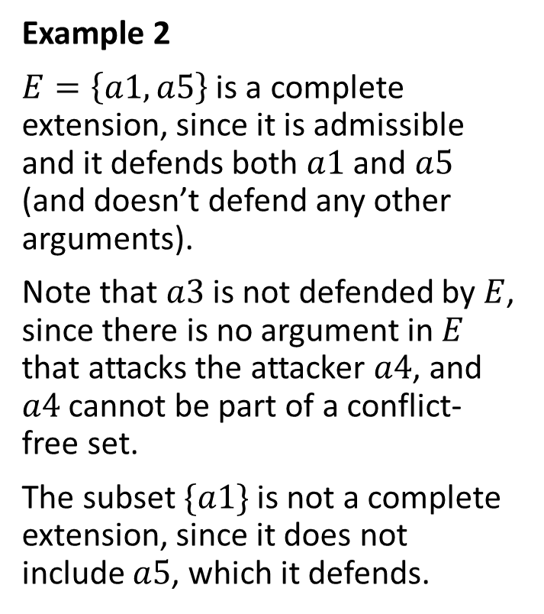
Complete extensions
A complete extension is an admissible subset that includes all arguments it defends.
Example 2
$E=\left\{a1,a5\right\}$ is a complete extension, since it is admissible and it defends both $a1$ and $a5$ (and doesn’t defend any other arguments).
Note that $a3$ is not defended by $E$, since there is no argument in $E$ that attacks the attacker $a4$, and $a4$ cannot be part of a conflict-free set.
The subset $\{a1\}$ is not a complete extension, since it does not include $a5$, which it defends.
a5
a2
a3
a4
a1
Note that we sometimes use a double-
headed arrow when there are attacks
in both directions.

Slide 6
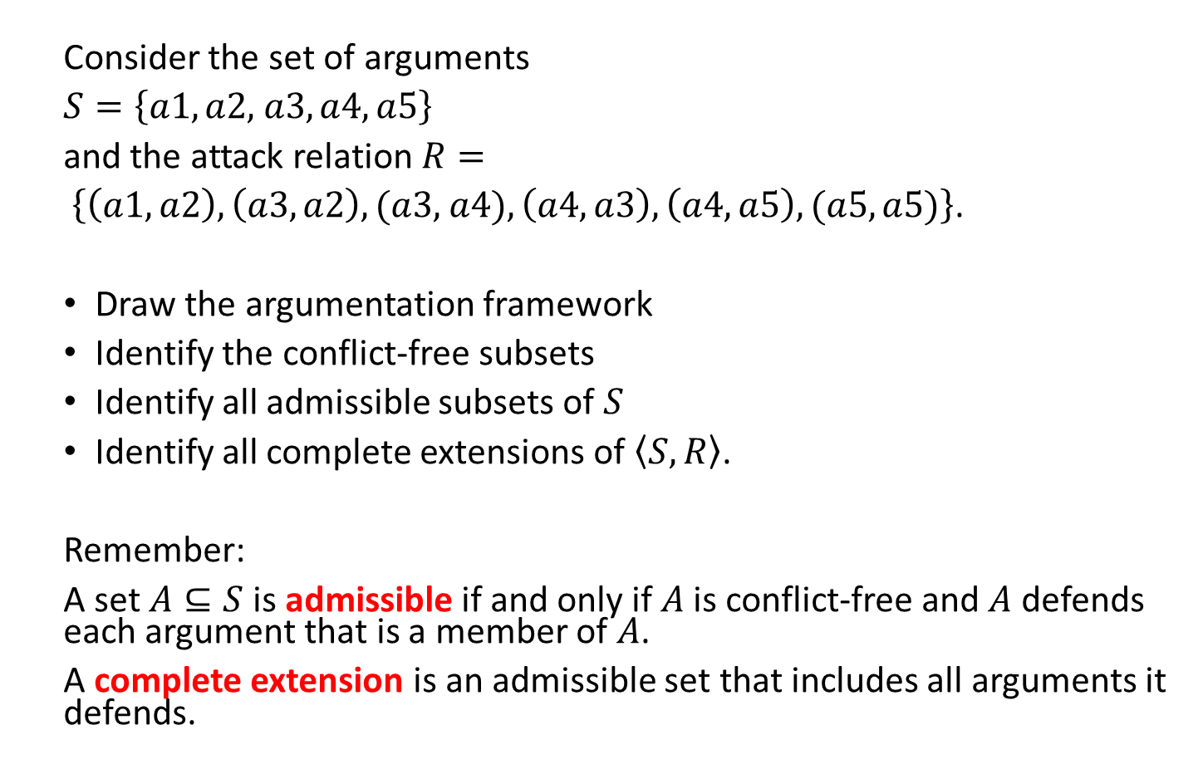
Exercise 4 (Example 3)
Consider the set of arguments
$S=\left\{a1, a2, \right.\left.a3, a4, a5\right\}$
and the attack relation $R=$
$\left\{\left(a1, a2\right), \left(a3, a2\right), (a3, \right.\left.a4),\left(a4, a3\right), \left(a4, a5\right),(a5,a5)\right\}$.
Draw the argumentation framework
Identify the conflict-free subsets
Identify all admissible subsets of $S$
Identify all complete extensions of $\left\langle S, \left.R\right\rangle \right.$.
Remember:
A set $A⊆S$ is admissible if and only if $A$ is conflict-free and $A$ defends each argument that is a member of $A$.
A complete extension is an admissible set that includes all arguments it defends.

Slide 7
Pause to do Exercise

Slide 8
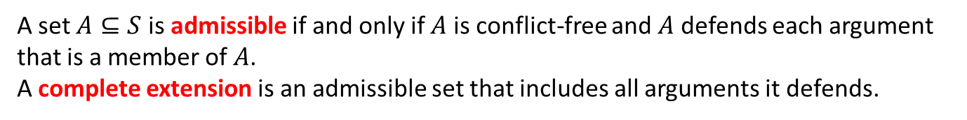
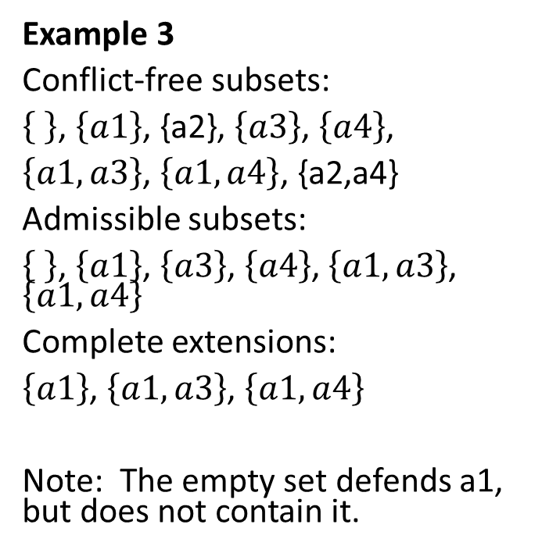
Exercise 4 Solutions (Example 3)
Example 3
Conflict-free subsets:
, $\left\{a1\right\}$, {a2}, $\left\{a3\right\}$, $\left\{a4\right\}$,
$\left\{a1,a3\right\}$, $\left\{a1, a4\right\}$, {a2,a4}
Admissible subsets:
, $\left\{a1\right\}$, $\left\{a3\right\}$, $\left\{a4\right\}$, $\left\{a1,a3\right\}$, $\left\{a1, a4\right\}$
Complete extensions:
$\left\{a1\right\}$, $\left\{a1,a3\right\}$, $\left\{a1, a4\right\}$
Note: The empty set defends a1, but does not contain it.
a5
a4
a2
a3
a1
A set $A⊆S$ is admissible if and only if $A$ is conflict-free and $A$ defends each argument that is a member of $A$.
A complete extension is an admissible set that includes all arguments it defends.

Slide 9
Note: Example 2 ≠ Example 3
a5
a4
a5
a2
a3
a4
a2
a3
a1
a1
Example 2
Example 3

Slide 10
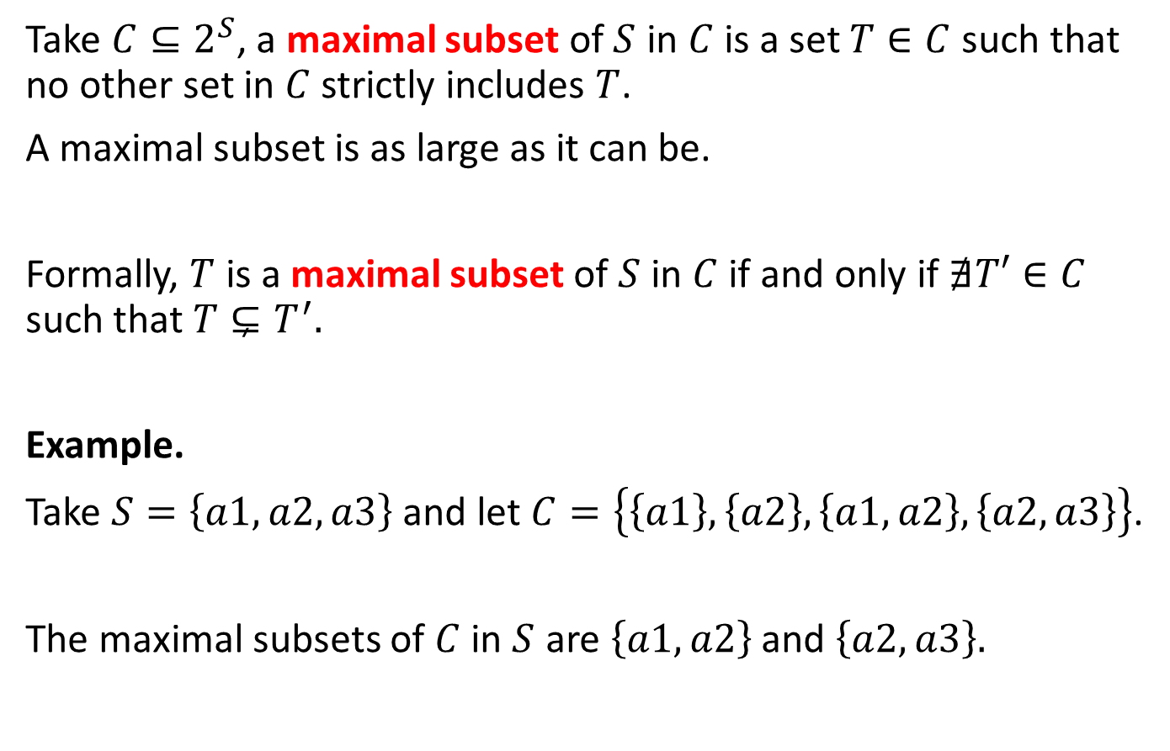
Maximal and minimal subsets
Take $C⊆2^{S}$, a maximal subset of $S$ in $C$ is a set $T∈C$ such that no other set in $C$ strictly includes $T$.
A maximal subset is as large as it can be.
Formally, $T$ is a maximal subset of $S$ in $C$ if and only if $∄T′∈C$ such that $T⊊T^{′}.$
Example.
Take $S=\left\{a1,a2,a3\right\}$ and let $C=\left\{\left\{a1\right\},\left\{a2\right\},\left\{a1,a2\right\},\left\{a2,a3\right\}\right\}$.
The maximal subsets of $C$ in $S$ are $\left\{a1,a2\right\}$ and $\left\{a2,a3\right\}.$

Slide 11
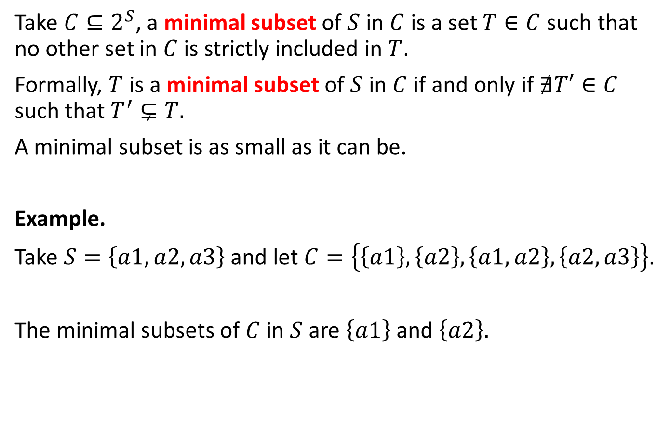
Maximal and minimal subsets
Take $C⊆2^{S}$, a minimal subset of $S$ in $C$ is a set $T∈C$ such that no other set in $C$ is strictly included in $T$.
Formally, $T$ is a minimal subset of $S$ in $C$ if and only if $∄T′∈C$ such that $T^{′}⊊T.$
A minimal subset is as small as it can be.
Example.
Take $S=\left\{a1,a2,a3\right\}$ and let $C=\left\{\left\{a1\right\},\left\{a2\right\},\left\{a1,a2\right\},\left\{a2,a3\right\}\right\}$.
The minimal subsets of $C$ in $S$ are $\left\{a1\right\}$ and $\left\{a2\right\}.$

Slide 12
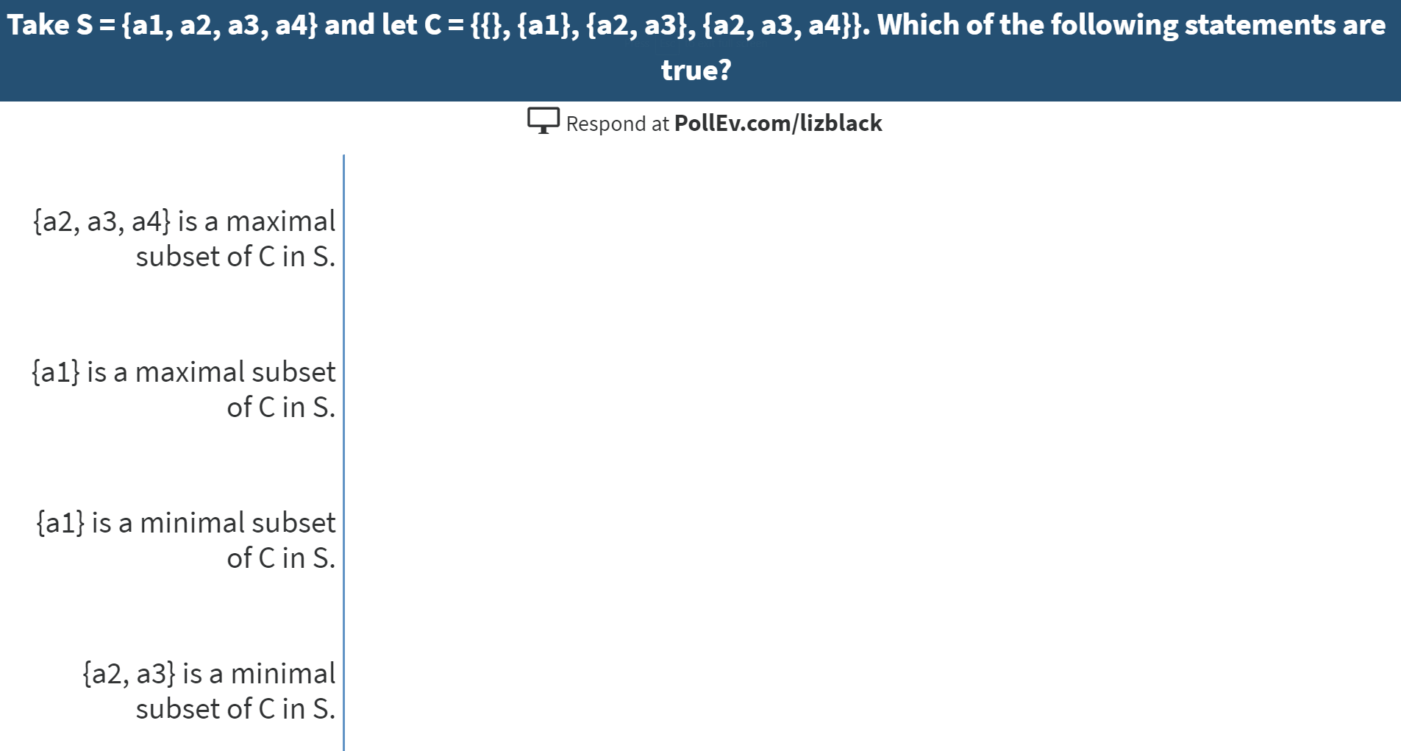
Correct answers:
{a2, a3, a4} is a maximal subset of C in S.
{a1} is a maximal subset of C in S.

Slide 13
Correct answers:
{a2, a3, a4} is a maximal subset of C in S.
{a1} is a maximal subset of C in S.

Slide 14
Grounded semantics
The grounded semantics aims to be cautious in the acceptance of arguments.
You can think of it as: “Accept only what is not controversial”.

Slide 15

Grounded extension
The grounded extension is the minimal complete extension with respect to set inclusion (ie, the minimal subset of the set of complete extensions).
Example 3
Conflict-free subsets:
, $\left\{a1\right\}$, {a2}, $\left\{a3\right\}$, $\left\{a4\right\}$,
$\left\{a1,a3\right\}$, $\left\{a1, a4\right\}$, {a2,a4}
Admissible subsets:
, $\left\{a1\right\}$, $\left\{a3\right\}$, $\left\{a4\right\}$, $\left\{a1,a3\right\}$, $\left\{a1, a4\right\}$
Complete extensions:
$\left\{a1\right\}$, $\left\{a1,a3\right\}$, $\left\{a1,a4\right\}$.
Grounded extension: $\left\{a1\right\}$.
a5
a4
a2
a3
a1

Slide 16

Grounded extension
The grounded extension always exists and it is unique.
The grounded extension could be empty.
a3
Example 4
Conflict-free subsets: , $\left\{a1\right\}$, $\left\{a2\right\}$ and $\left\{a3\right\}.$
Admissible subsets:
Complete extensions:
Grounded extension:
a1
a2

Slide 17
Exercise 5 (Example 5)
What is the grounded extension of the argumentation framework below?
a2
a3
a1
a4

Slide 18
Pause to do Exercise

Slide 19

Exercise 5 Solution
What is the grounded extension of the argumentation framework below?
a2
a3
Example 5
Conflict-free subsets: , $\left\{a1\right\}$, $\left\{a2\right\},$ $\left\{a3\right\}$, $\left\{a4\right\}$, $\left\{a1,a3\right\}$, $\left\{a1,a4\right\}$, $\left\{a2,a4\right\}$
Admissible subsets: , $\left\{a1\right\}$, {a3}, $\left\{a1,a3\right\}$
Complete extensions: $\left\{a1,a3\right\}$
Grounded extension: $\left\{a1,a3\right\}$
a1
a4

Slide 20
Preferred semantics
The preferred semantics tries to maximise the acceptance of arguments.
You can think of it as: “Accept as much as you can defend”.

Slide 21

Preferred extension
A preferred extension is a complete extension that is maximal with respect to set inclusion (ie, a maximal subset of the set of all complete extensions).
Example 3
Conflict-free subsets:
, $\left\{a1\right\}$, {a2}, $\left\{a3\right\}$, $\left\{a4\right\}$,
$\left\{a1,a3\right\}$, $\left\{a1, a4\right\}$, {a2,a4}
Admissible subsets:
, $\left\{a1\right\}$, $\left\{a3\right\}$, $\left\{a4\right\}$, $\left\{a1,a3\right\}$, $\left\{a1, a4\right\}$
Complete extensions: $\left\{a1\right\}$, $\left\{a1,a3\right\}$, $\left\{a1,a4\right\}$.
Preferred extensions: $\left\{a1,a3\right\}$, $\left\{a1,a4\right\}$.
a5
a4
a2
a3
a1

Slide 22
Exercise 6 (Example 5)
What are the preferred extensions of the argumentation framework below (Example 5)?
a2
a3
a1
a4

Slide 23
Pause to do Exercise

Slide 24

Exercise 6 Solution
What are the preferred extensions of the argumentation framework below?
Example 5
Conflict-free subsets: , $\left\{a1\right\}$, $\left\{a2\right\},$ $\left\{a3\right\}$, $\left\{a4\right\}$, $\left\{a1,a3\right\}$, $\left\{a1,a4\right\}$, $\left\{a2,a4\right\}$
Admissible subsets: , $\left\{a1\right\}$, $\left\{a3\right\}$, $\left\{a1,a3\right\}$
Complete extensions: $\left\{a1,a3\right\}$
Preferred extensions: $\left\{a1,a3\right\}$
a2
a3
a1
a4

Slide 25

Grounded, complete & preferred extensions for Example 3
Complete extensions: $\left\{a1\right\}$, $\left\{a1,a3\right\}$, $\left\{a1,a4\right\}$.
Preferred extensions: $\left\{a1,a3\right\}$, $\left\{a1,a4\right\}$.
Grounded extension: $\left\{a1\right\}$.
a5
a4
Example 3
The grounded extension is included in all preferred extensions.
The grounded extension coincides with the intersection of all complete extensions.
a2
a3
a1

Slide 26

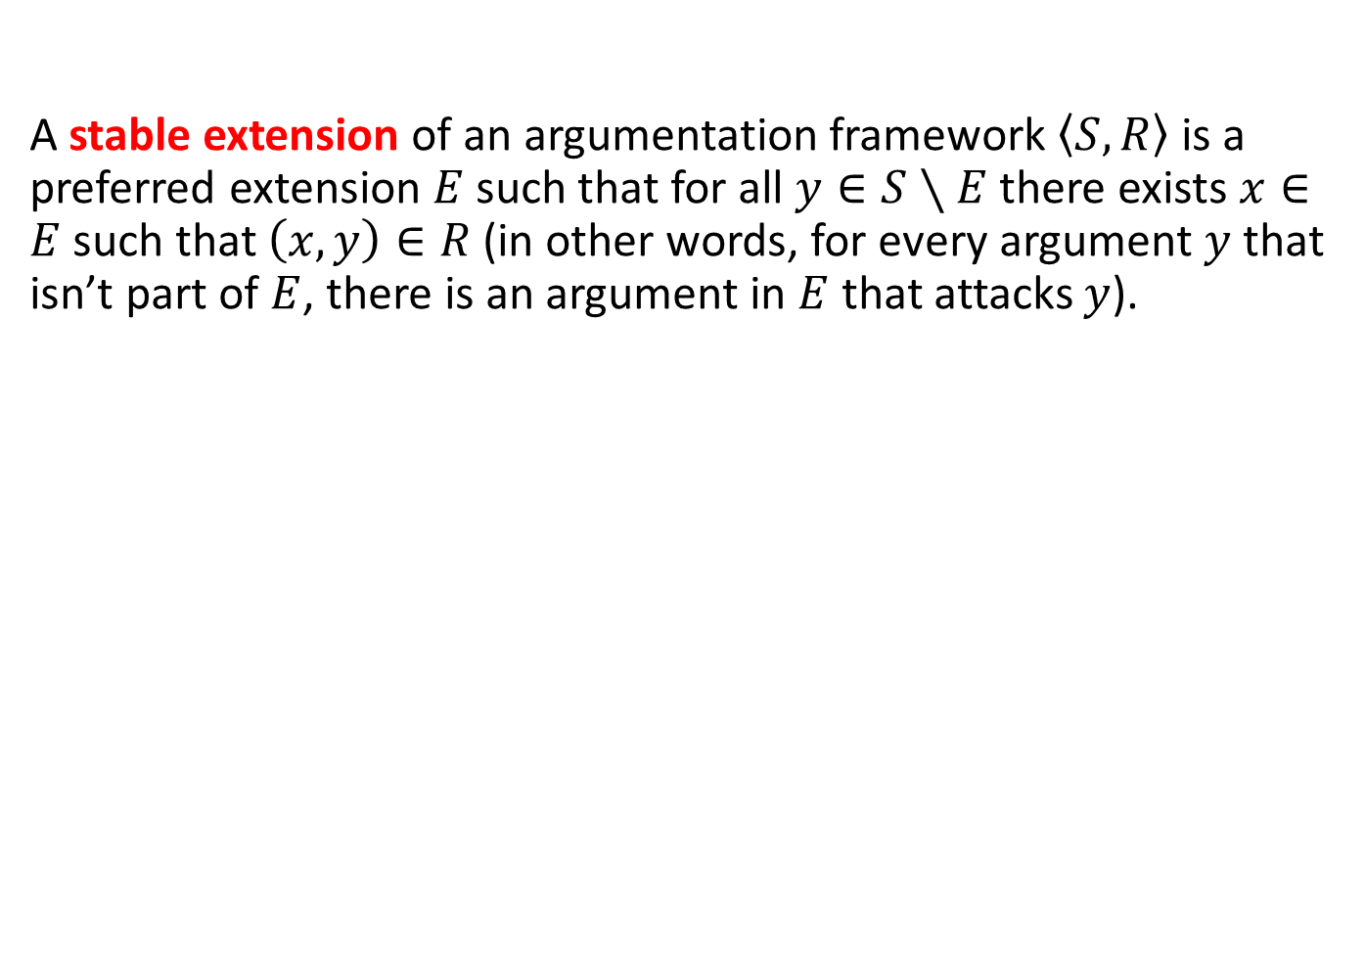
Stable extensions
A stable extension of an argumentation framework $\left\langle S, \left.R\right\rangle \right.$ is a preferred extension $E$ such that for all $y∈S∖E$ there exists $x∈E$ such that $\left(x,y\right)∈R$ (in other words, for every argument $y$ that isn’t part of $E$, there is an argument in $E$ that attacks $y$).
a5
a4
Example 3
Preferred extensions: $\left\{a1,a3\right\}$, $\left\{a1,a4\right\}$.
Stable extensions: $\left\{a1,a4\right\}$.
a2
a3
a1

Slide 27
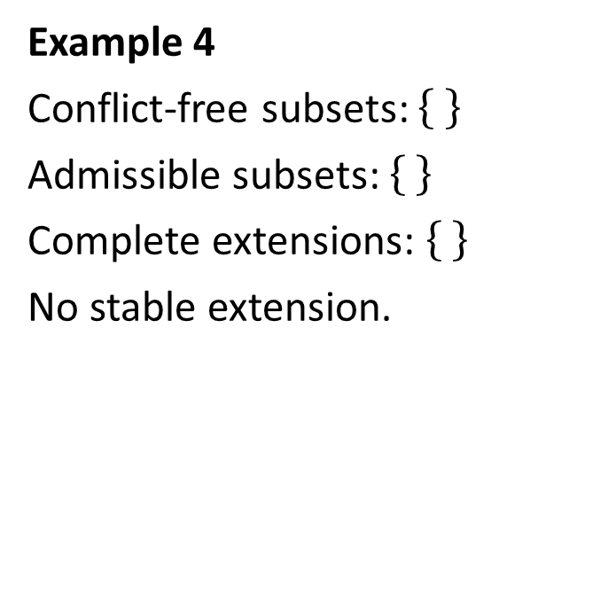
Stable extensions
Stable extensions do not always exist. In the framework of Example 4, there is no stable extension.
a3
Example 4
Conflict-free subsets:
Admissible subsets:
Complete extensions:
No stable extension.
a1
a2

Slide 28
Exercise 7
What are the stable extensions of the argumentation framework for Example 5?
a2
a3
a1
a4

Slide 29
Pause to do Exercise

Slide 30

Exercise 7 Solution
What are the stable extensions of the argumentation framework for Example 5?
Example 5
Conflict-free subsets: , $\left\{a1\right\}$, $\left\{a2\right\},$ $\left\{a3\right\}$, $\left\{a4\right\}$, $\left\{a1,a3\right\}$, $\left\{a1,a4\right\}$, $\left\{a2,a4\right\}$
Admissible subsets: , $\left\{a1\right\}$, $\left\{a3\right\}$, $\left\{a1,a3\right\}$
Complete extensions: $\left\{a1,a3\right\}$
Preferred extensions: $\left\{a1,a3\right\}$
Stable extensions: $\left\{a1,a3\right\}$
a2
a3
a1
a4

Slide 31
Credulous acceptance
An argument is credulously accepted by an argumentation framework under a particular semantics if and only if it is part of at least one of the extensions generated by those semantics.
For example, an argument is credulously accepted under the complete semantics if and only if it is part of at least one complete extension.

Slide 32
Skeptical acceptance
An argument is skeptically accepted by an argumentation framework under a particular semantics if and only if it is part of all of the extensions generated by those semantics.
For example, an argument is skeptically accepted under the complete semantics if and only if it is part of all of the complete extensions.

Slide 33
Exercise 8 – Example 6
Task: For each of the following semantics, determine which arguments are credulously accepted and which arguments are skeptically accepted: complete, grounded, preferred, stable.
a3
a4
Example 6
There are 5 arguments, a1, a2, . . . , a5.
There are 4 attacks:
(a1, a2)
(a1, a3)
(a2, a1)
(a2, a4).
a1
a2
a5

Slide 34
Pause to do Exercise

Slide 35

Exercise 8 Solutions
Task: For each of the following semantics, determine which arguments are credulously accepted and which arguments are skeptically accepted: complete, grounded, preferred, stable.
The different semantics
Conflict-free subsets: , $\left\{a1\right\}$, $\left\{a2\right\},$ $\left\{a3\right\}$, $\left\{a4\right\}$, $\left\{a5\right\}$, $\left\{a1,a4\right\}$, $\left\{a1,a5\right\}$, $\left\{a2,a3\right\}$, $\left\{a2,a5\right\}$, $\left\{a3,a4\right\}$, $\left\{a3,a5\right\}$, $\left\{a4,a5\right\}$, $\left\{a1,a4, a5\right\}$,$\left\{a2,a3, a5\right\}$, $\left\{a3,a4,a5\right\}$
Admissible subsets: , $\left\{a1\right\}$, $\left\{a2\right\},$ $\left\{a5\right\}$, $\left\{a1,a4\right\}$, $\left\{a1,a5\right\}$, $\left\{a2,a3\right\}$, $\left\{a2,a5\right\}$, $\left\{a1,a4, a5\right\}$,$\left\{a2,a3, a5\right\}$
Complete extensions: $\left\{a5\right\}$, $\left\{a1,a4, a5\right\}$,$\left\{a2,a3, a5\right\}$
Grounded extension: $\left\{a5\right\}$
Preferred extensions: $\left\{a1,a4, a5\right\}$,$\left\{a2,a3, a5\right\}$
Stable extensions: $\left\{a1,a4, a5\right\}$,$\left\{a2,a3, a5\right\}$
a3
a4
a1
a2
a5

Slide 36


Exercise 8 Solutions
Complete extensions: $\left\{a5\right\}$, $\left\{a1,a4, a5\right\}$,$\left\{a2,a3, a5\right\}$
Grounded extension: $\left\{a5\right\}$
Preferred extensions: $\left\{a1,a4, a5\right\}$,$\left\{a2,a3, a5\right\}$
Stable extensions: $\left\{a1,a4, a5\right\}$,$\left\{a2,a3, a5\right\}$
a3
a4
Credulously accepted complete: all arguments.
Skeptically accepted complete: $a5$.
Credulously/skeptically accepted grounded: $a5$.
Credulously accepted preferred/stable: all arguments.
Skeptically accepted preferred/stable: $a5$.
a1
a2
a5

Slide 37
Summary
This week we have looked at different extension-based semantics that can be used to determine subsets of arguments one can reasonably accept.
There are several different ways of determining (or calculating) the semantics for argumentation frameworks and different algorithms for these. We don’t consider them in this module.

